Slide 1

CCP Session
Clarifying the Cloud Concepts
Tuesday 9th November 2021
https://www.youtube.com/watch?v=4Xlz8uSSvaY&list=PL33wbhevj9WZtwqGAG_Potq3zrPdYARMT&index=8&t=1401s&ab_channel=CITVPLUS 23:03
Sam Green
samjackgreen@gmail.com

Slide 2
Every course on the CCP begins by outlining some fundamental cloud concepts.
Fundamental = applicable to everything that follows
I think they are confusable. We should distinguish them.
Why? (1) exam questions (2) Speak the code. Learn what is valued in this industry.

Slide 3

Three areas I will cover
Elasticity and Scalability.
The “as a service” models.
The difference between FAULT TOLERANCE and HIGH AVAILABILITY
Systems
Services

Slide 4
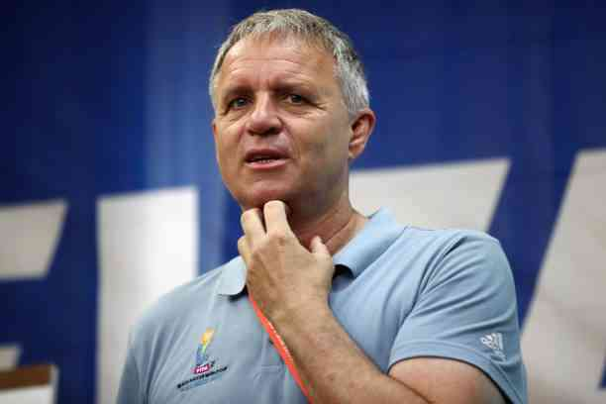
Saturday 12th June 2021
Christian Eriksen collapses on pitch
Jens Kleinfeld – German doctor

Slide 5
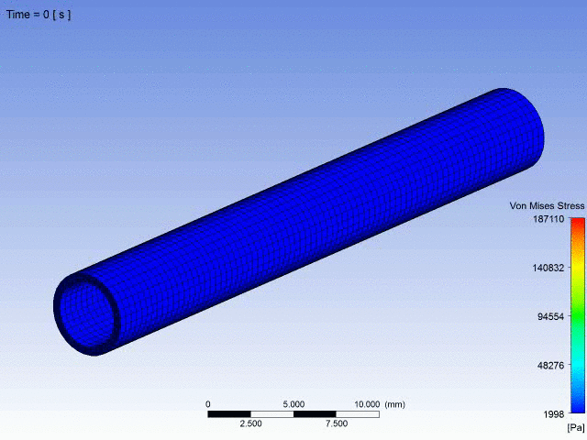




How is it possible to feel your pulse in your wrist?
Plumbers don’t feel the pulse of pipes.
Pipes have no elasticity.
ELASTICITY: expansion and contraction
Model of blood flowing through an blood vessel
Source: https://rescale.com/numerical-simulation-of-blood-flow-in-flexible-arteries-using-fluid-structure-interaction/
An elastic thing expands or contracts automatically

Slide 6

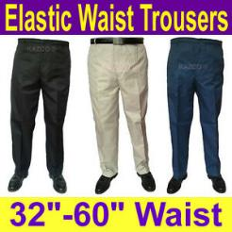
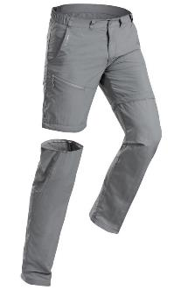


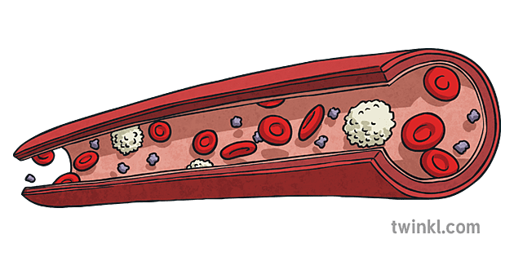
1 - Elasticity
Two key concepts
2 - Scalability
Something is scalable if it is easy/possible to expand it.
Modular units can be added on
(contrast this with SYSTEM = human brain)
Artery
Potentially both scalable and elastic

Slide 7
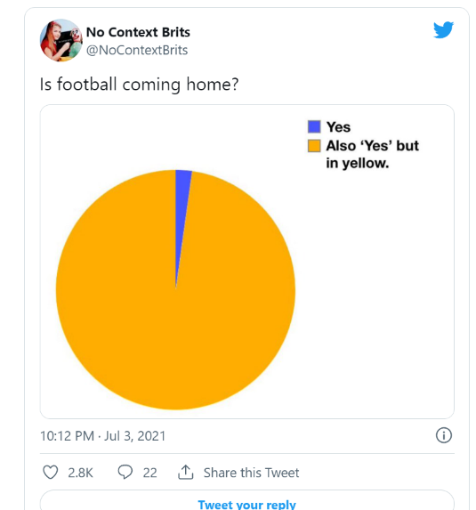

Slide 8

England make it to the final, playing Italy on Sunday 11th July 2020.
ITV host the game.

Slide 9
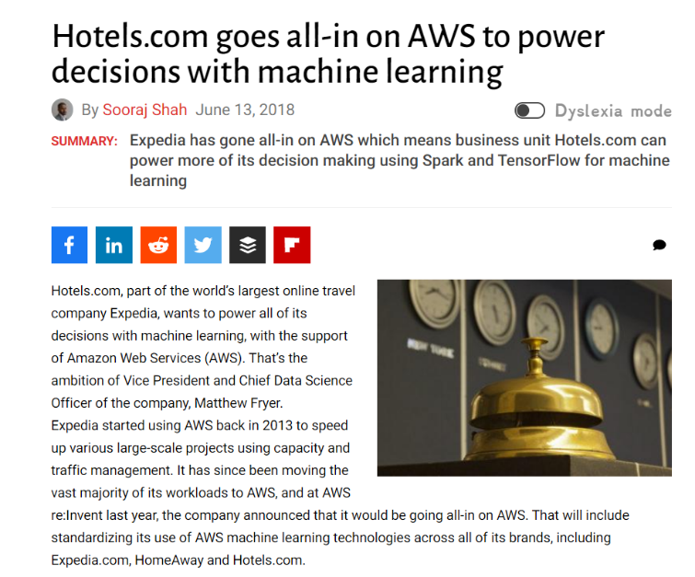

https://diginomica.com/hotels-com-goes-all-in-on-aws-to-power-decisions-with-machine-learning

Slide 10
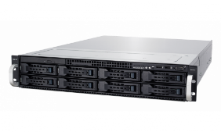
When the advertisement airs, the website experiences a spike in traffic.
Suppose Hotels.com are using EC2 Auto Scaling.

Slide 11
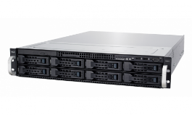
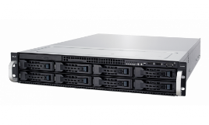

Traffic
Time
Advert airs on ITV

Slide 12
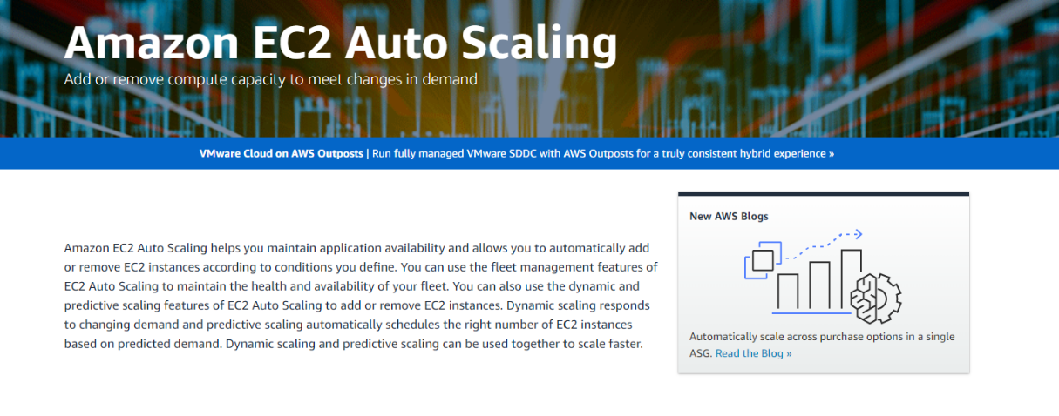

Slide 13

To summarise…
We have looked at ELASTICITY and SCALABILITY.
Elastic services increase to meet demand, then decrease.
EC2 Autoscaling is one example of a tool. Specifically, “Dynamic scaling responds to changing demand”
Responding to changing demand = elasticity

Slide 14
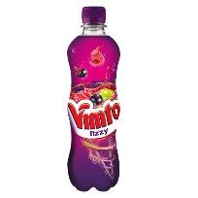

2 - As a Service
X as a service
We are going to look at three cases (three examples of X)
Think of the three cases as steps on a gradient
At one extreme, the customer who purchases the service is fairly self-reliant
At the other extreme, the customer who purchases the service is highly dependent

Slide 15
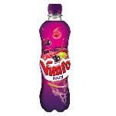

The Eight Layers
A
Application code
S
Abstract
Security
D
Database
O
ASDA
Vimto?
Nutritious?!
Such S****
Operating system
V
Virtualisation
N
Networking
S
Storage hardware
S
Server hardware
Physical

Slide 16




The Eight Layers
Competent at dealing with OS
Independent Ian
Decides to pay AWS for Infrastructure as a service
Application code
Security
Database
OS
Virtualisation
Networking
Storage hardware
Server hardware
Spend-happy Simon
Decides to pay AWS for Software as a service
Competent at dealing with application code themselves
Pragmatic Patricia
Decides to pay AWS for Platform as a service
Principle 1: AWS necessarily provides hardware → You start at the bottom of the stack, not the top.

Slide 17
The three “as a services” lie on a spectrum
I’ll need 7 of the layers, AWS. I will pay for 7 layers.
I can deal with the most abstract layer myself, so will not need to pay AWS for this.
Provide me the fundamental, physical resources, AWS. I will pay for just these 4 layers.
I do not need the 4 more abstract levels, so shall not pay AWS for these 4 levels.
Do everything for me, AWS! I will pay you for all 8 layers.
PaaS
IaaS
SaaS

Slide 18
Three things to remember
The three models encapsulate one another
2. PLATFORM lies between IaaS and SaaS.
3. With IaaS, you get AWS to sort out the bottom FOUR layers.

Slide 19
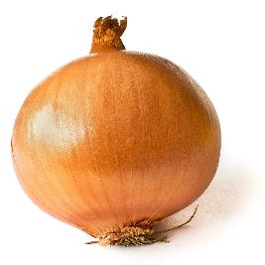
Software as a Service, or
Infrastructure, and platform, AND software as a service!

Slide 20
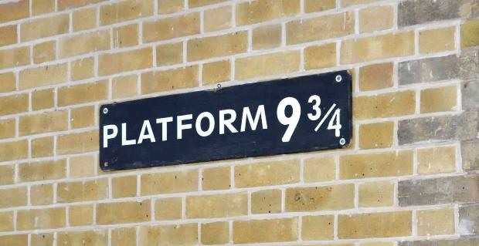

A second thing to note
The word PLATFORM is vague.
It is hard to remember which model the word “platform” denotes.
When you come across the word PLATFORM, out of the blue, I can easily imagine it being either of these:
Guess which is PaaS!
What are the ODS you’ll get it right?

Slide 21
Independent Ian
Decides to pay AWS for Infrastructure as a service
Ian is dealing with the OS himself.
So, has he purchased a PLATFORM from AWS?
“Platform” → OS
“Platform” → DATABASE
“Platform” → SECURITY
NO
John is dealing with the application code himself.
So, has he purchased a PLATFORM from AWS?
Possibly
PLATFORM-ODS-PLATFORM-ODS-PLATFORM-ODS-PLATFORM-ODS-PLATFORM-ODS-PLATFORM-ODS-PLATFORM-ODS

Slide 22

Fig 1. People trying to beat the odds. Notice the table… or platform. ODS – Operating system, Database, Security

Slide 23
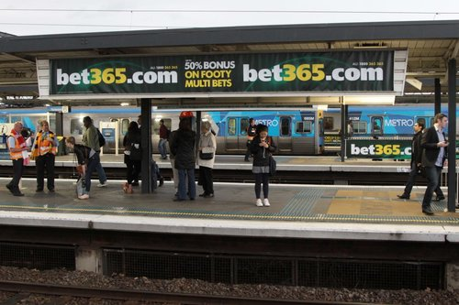
Think PLATFORM. Think ODS.

Slide 24

Three things to remember
The three models encapsulate one another
SaaS implies a platform is present, and an infrastructure
2. PLATFORM lies between IaaS and SaaS.
You pay AWS to sort out 7 out of 8 layers.
3. With IaaS, you get AWS to sort out the bottom FOUR layers.
IaaS implies a nice, symmetrical split of the 8 layers.

Slide 25

Three areas I will cover
Elasticity and Scalability ✓
The “as a service” models ✓
The difference between FAULT TOLERANCE and HIGH AVAILABILITY
ASDO VN?! SS

Slide 26
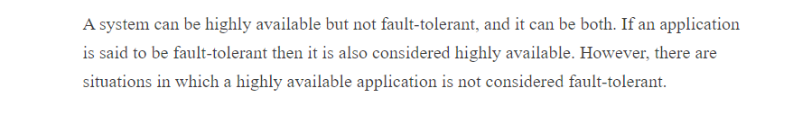
highly available
fault tolerant
Sources
Jon Bonso https://www.linkedin.com/pulse/high-availability-vs-fault-tolerance-jon-bonso/
IBM https://www.ibm.com/docs/en/powerha-aix/7.2?topic=aix-high-availability-versus-fault-tolerance

Slide 27
Fault tolerance (FT) is more demanding than high availability.
If an application is fault tolerant, then it is highly available.
A square with three sides.
I will now give some remarks about each (FT and HA) so we can understand why FT is more demanding, rather than having to remember by rote.

Slide 28

Fault tolerant
“fault-tolerant” - a strange term. Why not fault-free?
Such systems have two capabilities. They are capable of experiencing faults and capable of dealing with them.
The fault never surfaces or becomes problematic (or is never observed).Put simply, the system tolerates the fault.
The fault never results in the system-in-which-it-occurs losing its availability

Slide 29
Taxonomy of Faults
The fault never results in the system-in-which-it-occurs losing its availability
Fault that allows the system to stay up
Fault that results in the system going down
Fault tolerance is defined in terms of certain faults in systems. Namely, it is concerned with FATAL FAULTS – faults that bring a system “down”.
Availability is also a function of fatal faults. But while FT requires the capacity to experience faults, it is not obvious that availability has this demand [SO?] “Availability” is ambiguous. We might ask (1) whether some system is available or (2) what a system’s availability is. For (1), a valid answer is some percentage but for (2) a valid answer is “YES/NO”.
Argument for all FT necessarily being HA
(1) If a system is fault tolerant then it is not capable of experiencing fatal faults.
(2) If you are incapable of experiencing fatal faults then you are never down.
(3) If you are never down, then you are always available.
(4) If you are always available then you are highly available.
Therefore, if a system is fault tolerant, then it is highly available.

Slide 30
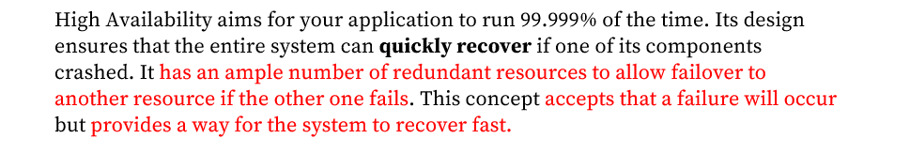
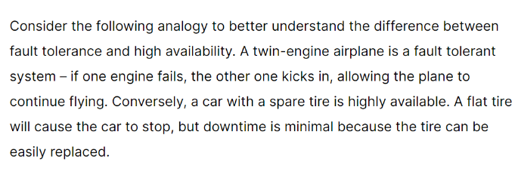

Slide 31
Analogy
Likewise, consider FAULT TOLERANCE.
A fault tolerant [system] isn’t just…
a system not experiencing faults.
FT involves managing faults, and controlling them.
e.g. a system that had no faults would probably have no complexity. It would probably never evolve, or improve. When the system failed, it would probably fail completely.
Fault tolerance involves faults.
Consider COURAGE.
A courageous [person] isn’t just…
someone not experiencing fear.
Courage involves managing your fear, and controlling it.
e.g. someone who had no fear of being immoral or did not fear their loved ones being harmed. This would not be a courageous person.
Courage involves fear.

Slide 32
Now high availability.
For a service to be highly available is simply for it to have a high degree of availability.
“Highly” is a relative term. (“When does an available service become a highly available service?”) Note: it is not necessarily a bad thing that we cannot provide an answer.
Very dark room ------ highly available service
PERHAPS the capacity to tolerate faults also comes in gradations (just like availability). Some systems are highly fault tolerant, while others are moderately fault tolerant.
However, the fact is that it’s unhelpful to talk about gradations of fault tolerance. [WHY?]

Slide 33
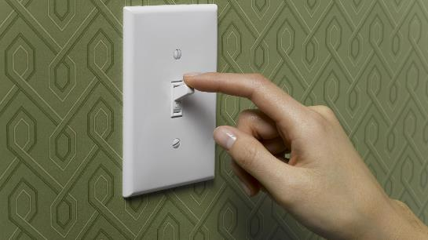
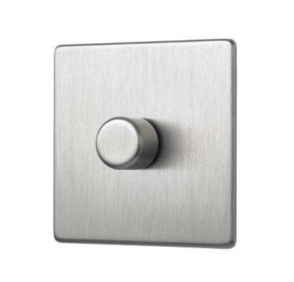
FT
Systems are either fault tolerant or not fault tolerant.
Like a light switch ‘it is a convenient fiction that each switch must be definitely on or definitely off. There must be intermediate positions, but for most purposes we can forget about them. Turing 1950
Systems are available to some degree.
Availability

Slide 34
If one measure comes in gradations, while another is “ON-OFF”, which would you naturally say is more demanding (the gradation one or the ON-OFF one)?
(1) Surely the ON-OFF measure is more demanding.
(2) Fault Tolerance is the ON-OFF measure.
Therefore, fault tolerance is more demanding.

Slide 35
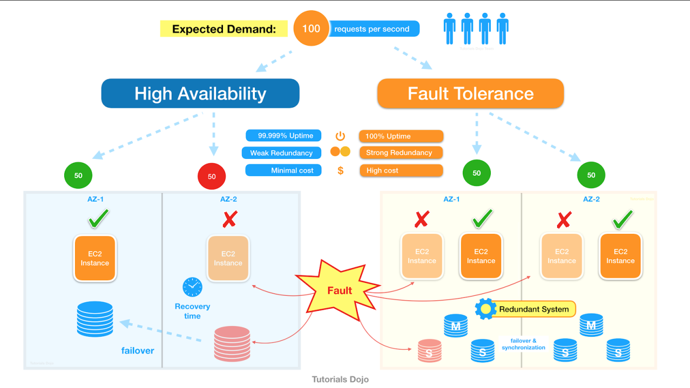

Slide 36
FT, HA and value
It can be perverse/unnatural to implement FT, because of how much redundancy it requires.
We have to think about what we value
Would you—really—want a fault tolerant wardrobe?
The Case of the Aid Package Website. Not mission critical. What would you undermine if you made them pay for fault tolerance? What a mistake that would be.
Going further: the case of SYSTEM = [your family]. Would you make the system FT free of charge, if you could? Of course not. Here, we value repair of parts, not replacement.

Slide 37

“As soon as we start maintaining something as if it were a fault tolerant system, you start viewing its parts as being independent of one another and replaceable”
- Sir Rod Stewart

Slide 38

And this gets to the heart of the issue
It’s often supposed that because FT achieves 100% uptime, and HA is about 99.999% available…
“FT is just a tiny step beyond HA.”
Yes… and no
Notes:
FT is a different game entirely. You have to take a different perspective towards the system.

Slide 39
What it’s actually like
What you think it’s like
Cost and effort
Cost and effort
Availability
Availability
Are you SURE you want FT?

Slide 40
“The fault tolerant system experienced downtime” = The square didn’t have four sides
(A highly available system can be capable of experiencing downtime)

Slide 41
How serious are the consequences of a system not being available (i.e. down)?
(1) SYSTEM = aeroplane engine
(2) SYSTEM = circulatory system
(It seems to me that redundancy is only realistically achievable in (1))
Fault tolerance may be desirable, e.g.:

Slide 42
We have looked at
Elasticity and Scalability.
The “as a service” models.
The difference between FAULT TOLERANCE and AVAILABILITY.

Slide 43
Further reading
on fault tolerance and high availability (not AWS in particular, just general)
Jon Bonso (2020). High Availability Vs Fault Tolerance. Available at: https://www.linkedin.com/pulse/high-availability-vs-fault-tolerance-jon-bonso/
IBM. High availability versus fault tolerance. Available at: https://www.ibm.com/docs/en/powerha-aix/7.2?topic=aix-high-availability-versus-fault-tolerance
Jim Gray (1985). Why do computers stop and what can be done about it?
Chris Colohan (2016). The many types of fail. Available at: https://www.youtube.com/watch?v=MnYlwjuGcg8&ab_channel=DistributedSystemsCourse
He’ll introduce you to Byzantine failures, which Barbara Liskov talks about in the following.
Barbara Liskov (2001). MIT: Colloquium on Practical Byzantine Fault Tolerance. Available at: https://www.youtube.com/watch?v=Uj638eFIWg8&ab_channel=MITVideoProductions
Miguel Castro (2001). Practical Byzantine Fault Tolerance. Available at; http://publications.csail.mit.edu/lcs/pubs/pdf/MIT-LCS-TR-817.pdf

Slide 44
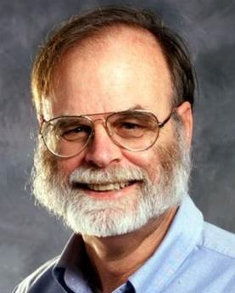
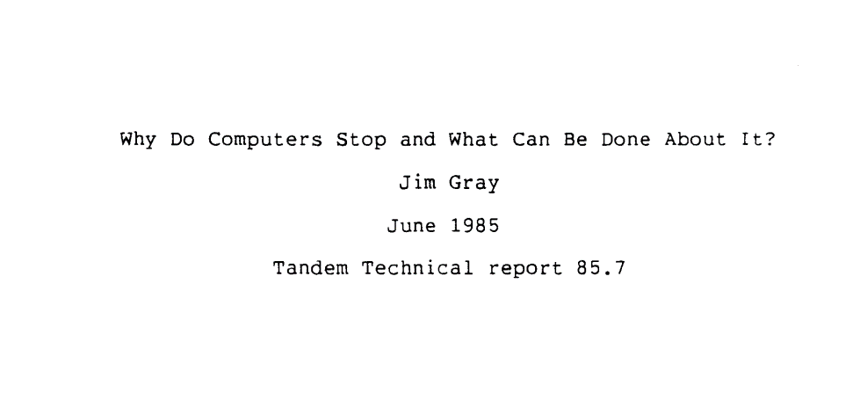
Gray has no sentence that explicitly distinguishes fault tolerance from high availability, using those terms.
However, both these concepts are addressed in his paper.

Slide 45
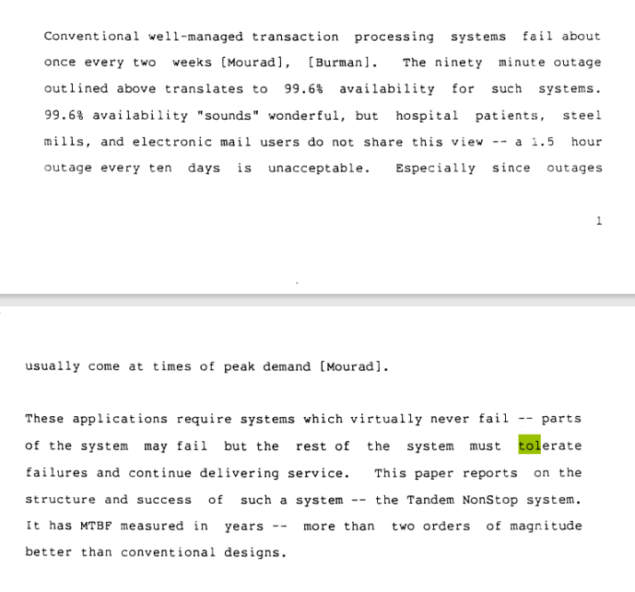
Gray is talking about a fault-tolerant system
“the rest of the system must tolerate failures and continue delivering service”

Slide 46
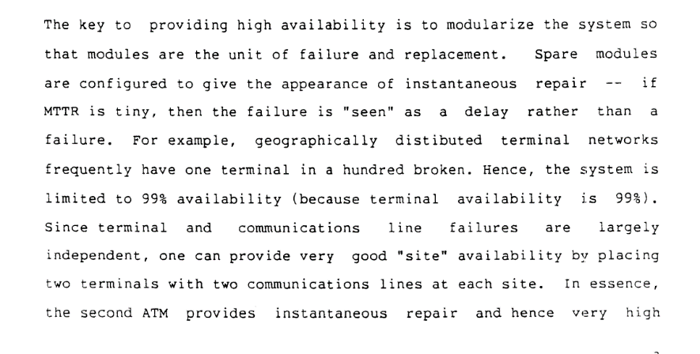
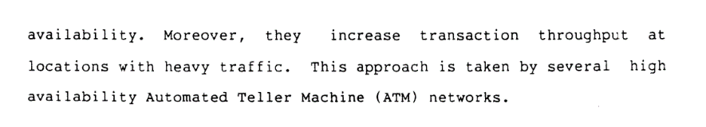

Slide 47
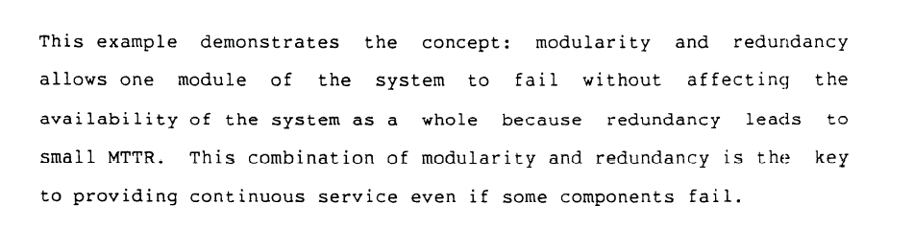

Slide 48
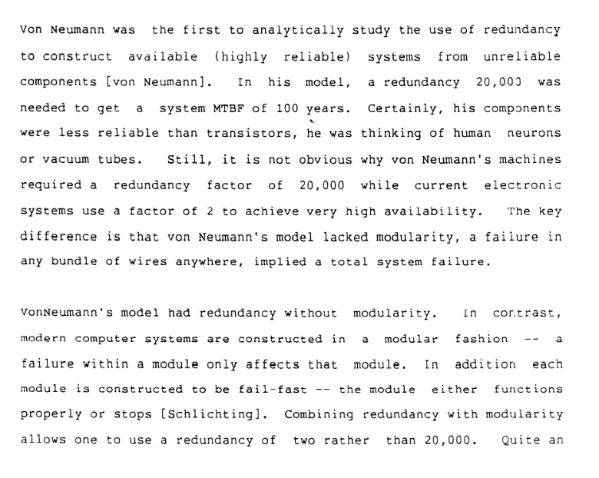

Slide 49
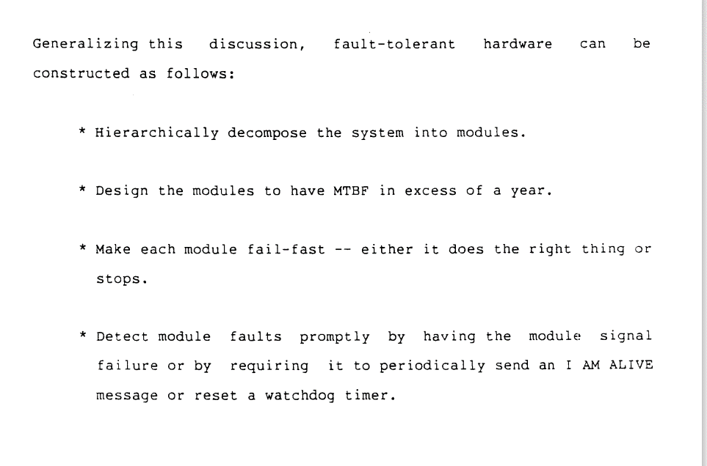

Slide 50
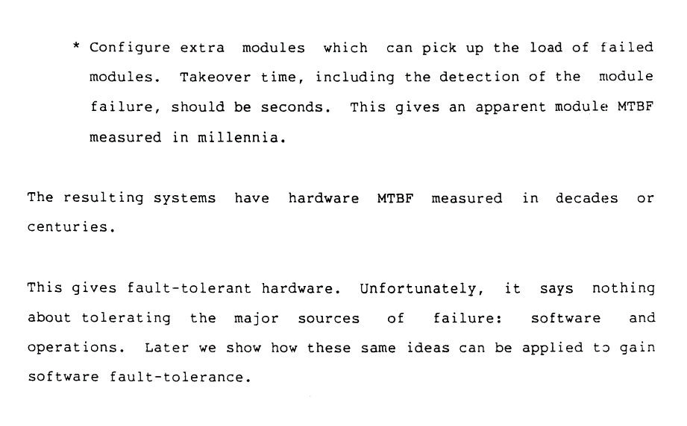

Slide 51
How to achieve FT
1 – Modularization
2 – Make each module fail infrequently
3 – Make each module fail-fast
4 – Detect module faults prompty
5 – Configure spares capable of picking up the load of the failed module

